Slide 1
OGC Working Groups and Initiatives for GeoScience
Mickaël BEAUFILS (BRGM)
Geotechnical Data Standardization Workshop
Paris, France - 22 January 2019

Slide 2
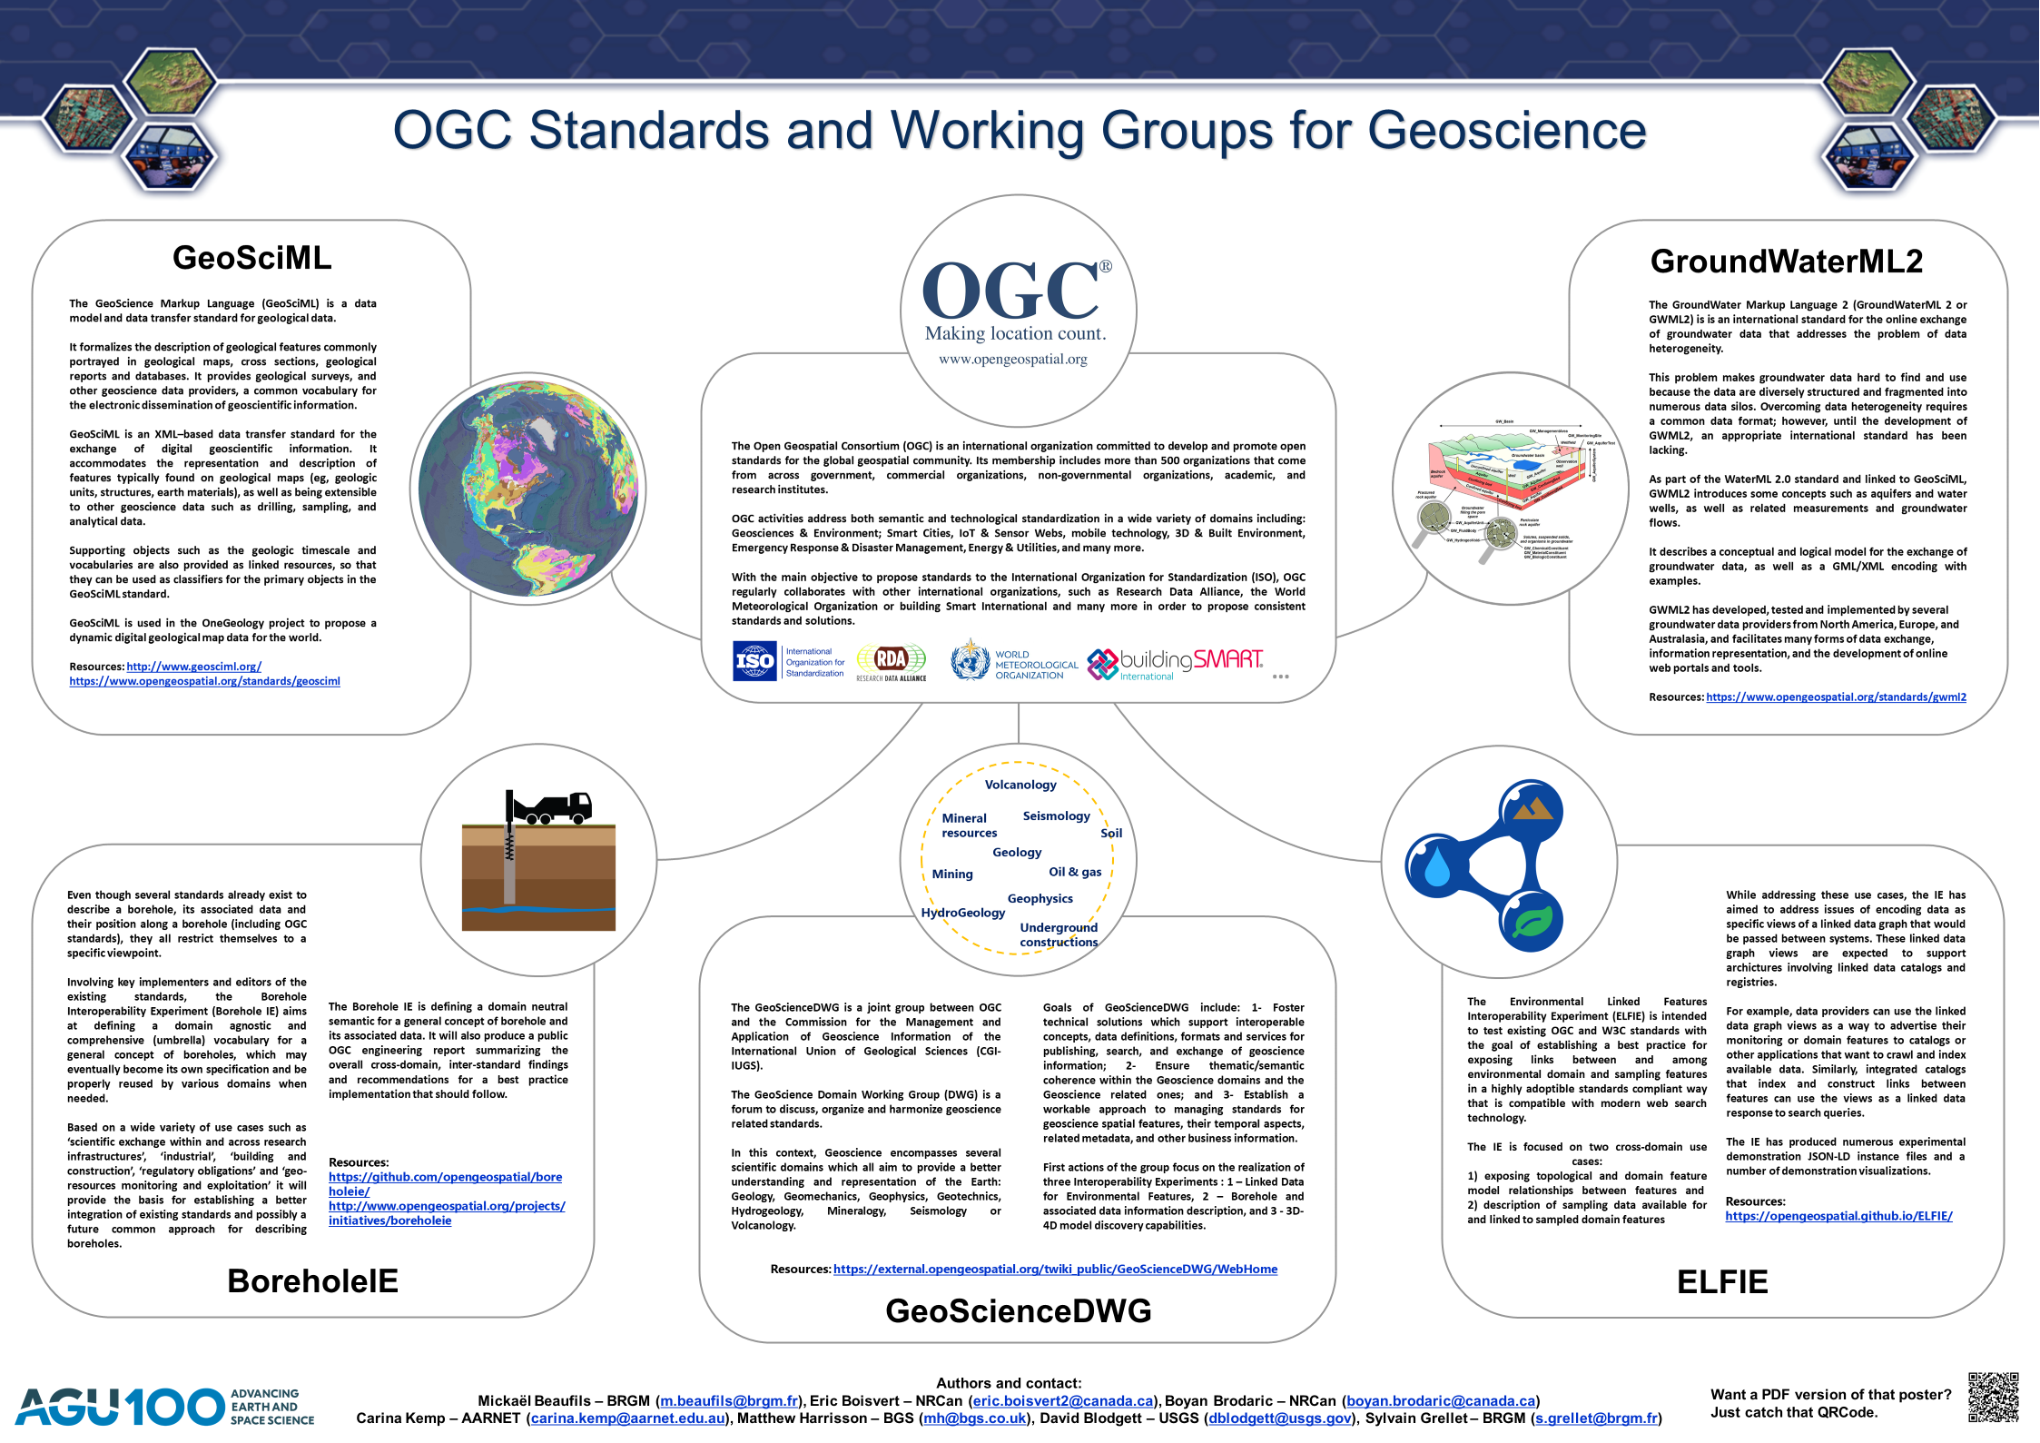
2
3
1

Slide 3

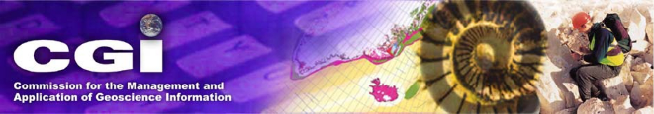

What is the OGC GeoScience DWG ?
The joint Domain Working group (DWG) between OGC and CGI-IUGS
Officially created in September 2017
One goal: leveraging geoscience data interoperability
Co-chairs: Mickaël Beaufils (BRGM) & Carina Kemp (ex.Geoscience Australia)
Geospatial Data Standardization
Geoscience Data Community

Slide 4
GeoScience DWG perimeter
Volcanology
Agriculture oriented WG
Technology oriented WG
Mineral
resources
Seismology
Soil
GeoScience DWG
Climate
oriented WG
Geology
City & infrastructure oriented WG
Mining
Oil & gas
Geophysics
Hydrology oriented WG
HydroGeology
Underground
constructions

Slide 5
















Ensure proper connections with other groups
GeoScience DWG
Earth, Space, and Environmental Sciences
Interest Group
… and many others

Slide 6


Connect people interested in the geoscience topic
Exploring GeoScienceDWG horizons
(Presentation session from March 2019 - Orleans TC)
Volcanology
BIM and Geomodelling (Mickaël Beaufils - BRGM)
LIDAR and Geomodelling (Thomas Dewez - BRGM)
Seismology (Aurelien Dupont - EMSC)
Volcanology (Jean-Marie Saurel – IPGP)
Mining (Andrew Scott - GMSG)
Soil (Josh Liebermann - Tumbling Walls LLC)
AstroGeoScience (Mark Hunter - USGS)
Mineral
resources
Seismology
Soil
WP8
Geology
Oil & gas
WP11
Mining
Geophysics
HydroGeology
Underground
constructions

Slide 7
Borehole IE
Borehole Interoperability Experiment targeting a common Borehole conceptual model
Borehole is a core concept in geoscience
Several existing standards
Cross-countries initiatives on the run to push standard usage (EPOS, …)
Done:
Kick-off in June 2018
Definition of use cases: position along borehole, geotechnics, from raw data to interpretation, hydrogeologic boreholes, …
Review of semantics
On-going:
Comparison with EPOS model

Slide 8
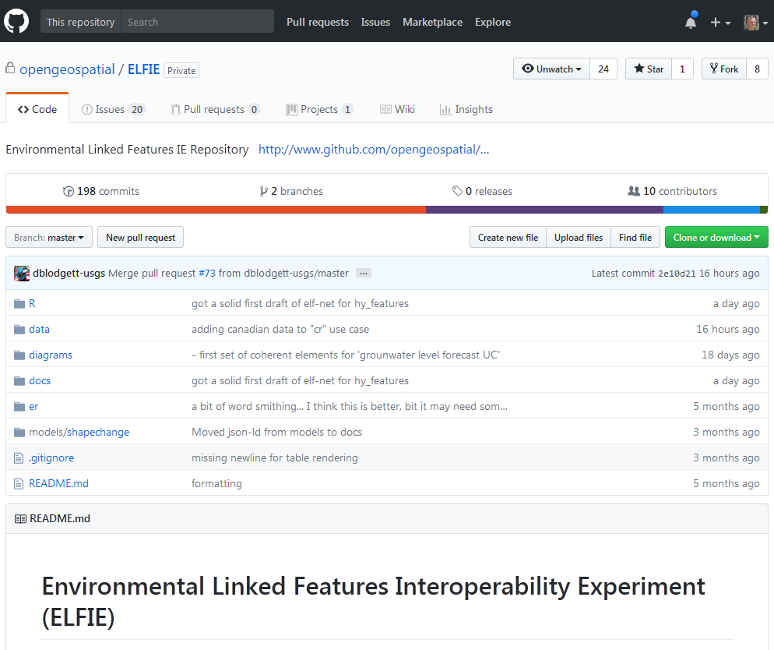
Environmental Linked Features IE (ELFIE)
Demonstrate the use of existing and pending OGC standards for the encoding of environmental observation data in an integrated dataset of features linked according to ReSTful and Linked Data principles.
From: https://github.com/opengeospatial/ELFIE
Initiators:
U.S. Geological Survey (US)
Land Information New Zealand (NZ)
BRGM (FR)
Participants
Tumbling Walls and Dewberry (US)
Meta-linkage (AU)
INSPIRE (EU)
Natural Resources Canada (CA)
Manaaki Whenua and Horizons Regional Council (NZ)

Slide 9
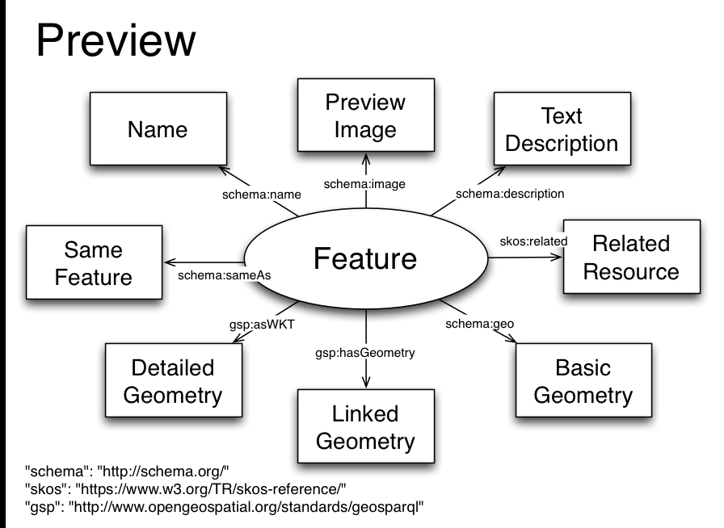
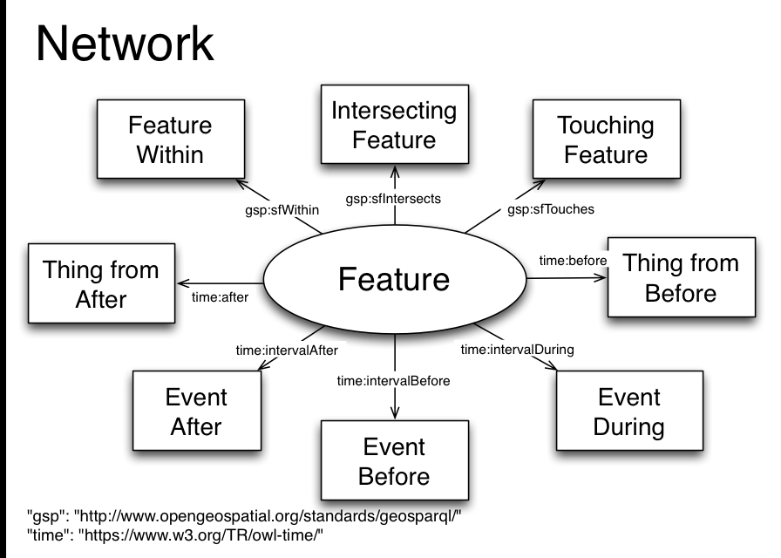
Environmental Linked Features IE (ELFIE)
Two good reasons to use Linked Data
Complex data with many attributes and properties
Load the Index feature and discover the rest
Data collection and connected data (lineage)
Load One feature and discover the others through their relationships

Slide 10
In a nutshell
GeoScienceDWG offer a forum to discuss and organize activities for geoscience data standardization
Interesting things for Geotechnics
Borehole IE to harmonize geotechnical data obtained via borehole
ELFIE principles to enable data access and discovery + lineage
What about the integration of sismic modeling in BIM ?
Second ELFIE is starting and we have a Model IE in the box
Join us!

Slide 11
Thanks for your attention
m.beaufils@brgm.fr

